Slide 1
Alan Turing – May 31
Agenda
Alan Turing
Discussion: Enigma Machine & Other Things
Movie: Imitation Game
Mod C.5 Artificial Intelligence
Level 1 & 2 - Complete
Level 3 & 4 – Next Week
Upcoming
Continue Movie & Mod C.5

Slide 2
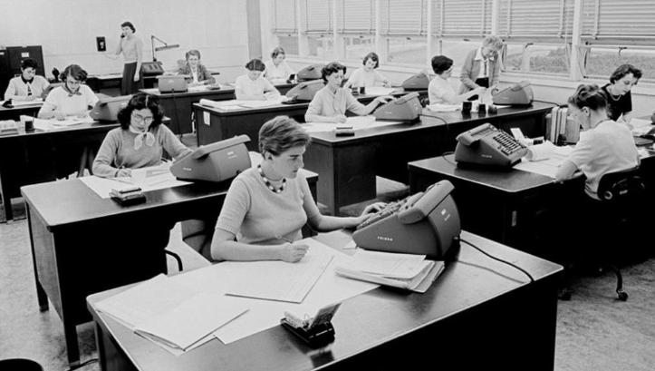
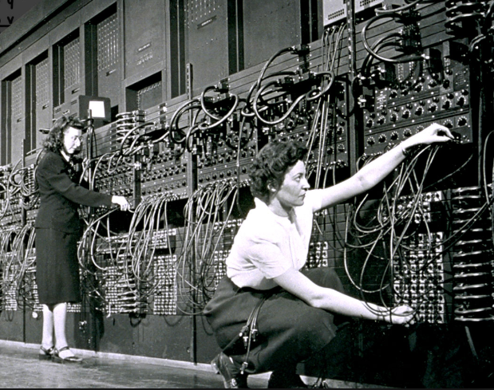
Early Computers
In the 1940’s
Being a “Computer” was a job description for work done by a human
The job required excellent concentration and mathematical skills
Most computers were women
In the 1950’s
“Electronic Computers” were introduced
Many of the first computer programmers were people who used to be “Computers”
Present times
The term “Electronic Computer” has been shortened to be just “Computer”

Slide 3
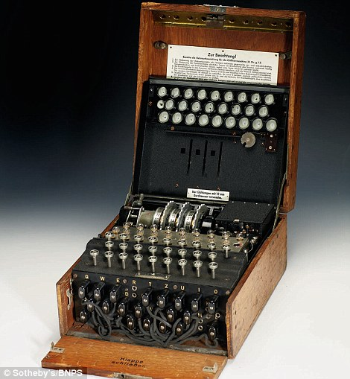
Alan Turing
The Enigma (WWII)
Encrypted Code used by the Germans for secret communications
Code was “cracked” by the British
Using the first electronic computer
Main reason for winning the war
Enigma Code Machine Used by the Germans

Slide 4
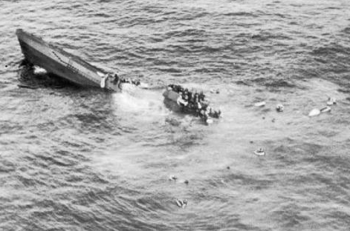
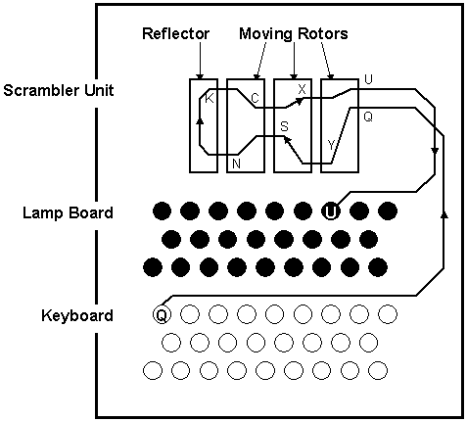
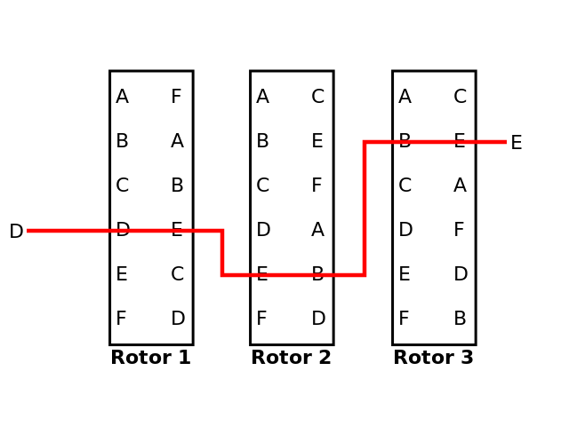
The Enigma Code
Was based on three rotors
There was a collection of more than three rotors
Each rotor could be rotated to a different position
This resulted in millions of combinations
Every day …
3 different rotors were selected
Each rotor was set to a different position
These settings were determined in advance

Slide 5
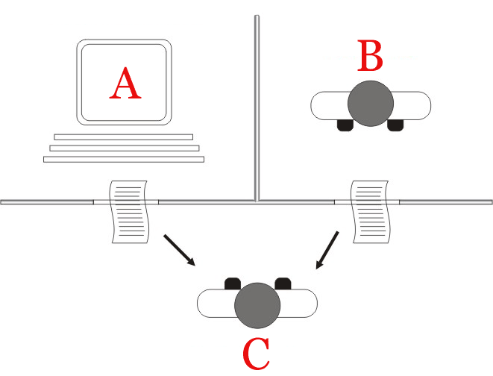
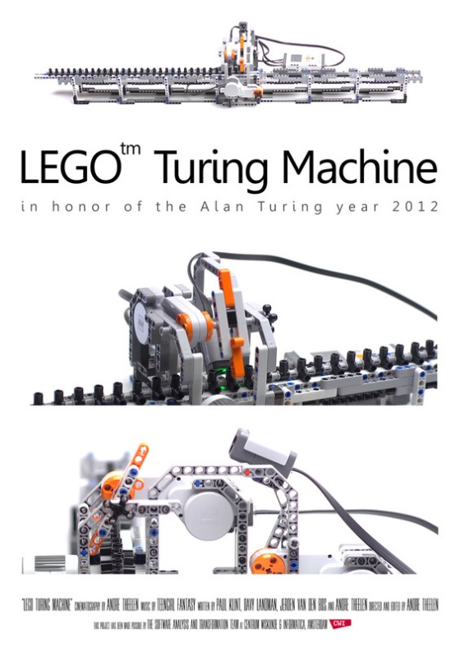
Alan Turing (Continued)
Was a Brilliant Founder of modern Computer Science
Turing Machine
Turing Test
His status as a War Hero was unknown during his life
Enigma Work remained Top Secret Classified (MI6) until declassified in the 1980’s
He was persecuted for his Sexual Orientation
Repeatedly arrested by the British Government
Eventually driven to Suicide

Slide 7

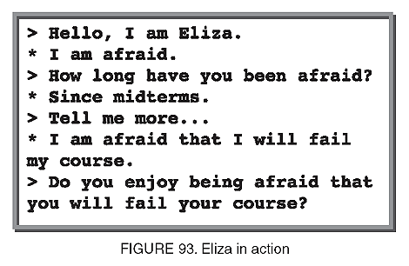
Eliza (1966)
First example of a Natural Language AI
Simulates a On-Line Therapy Session
Proved that a computer had the potential to fool people
URL
http://psych.fullerton.edu/mbirnbaum/psych101/Eliza.htm

Slide 8
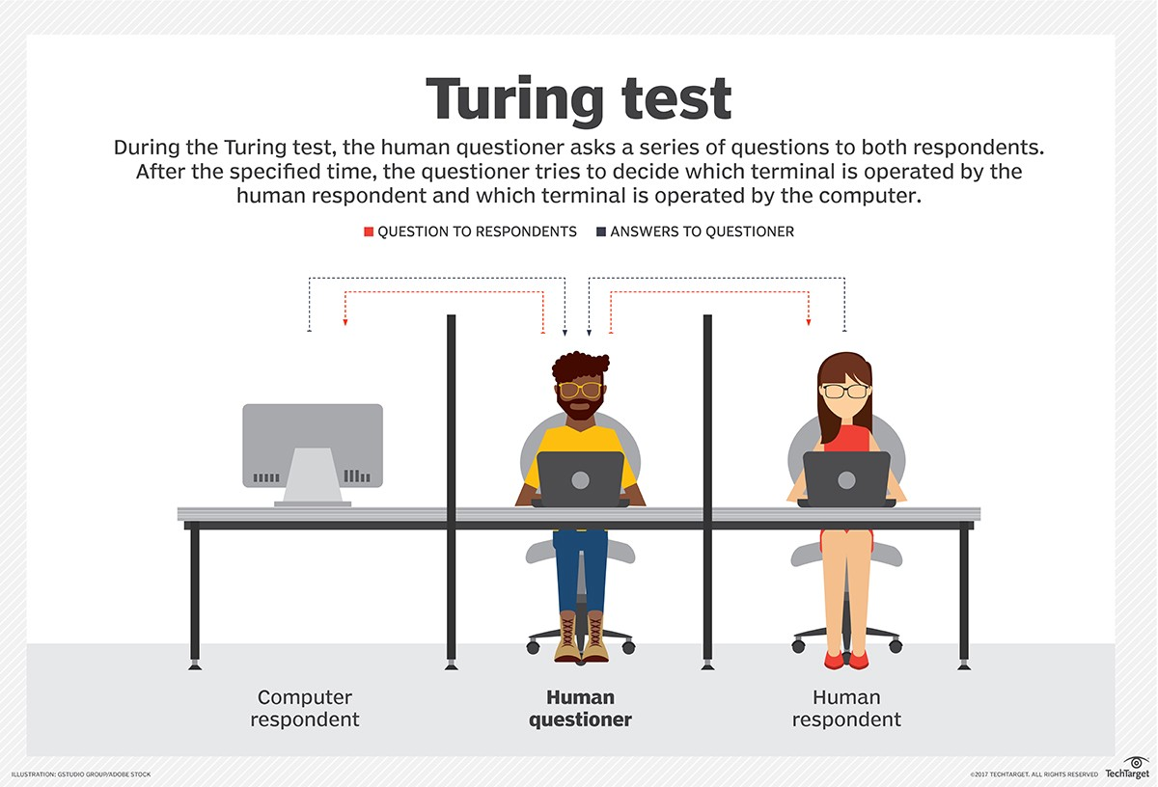
Turing Test (1950)
Developed by Alan Turing (more about him later)
A theoretical test / standard for what would be considered Intelligent
Video
https://ed.ted.com/lessons/the-turing-test-can-a-computer-pass-for-a-human-alex-gendler

